Slide 1
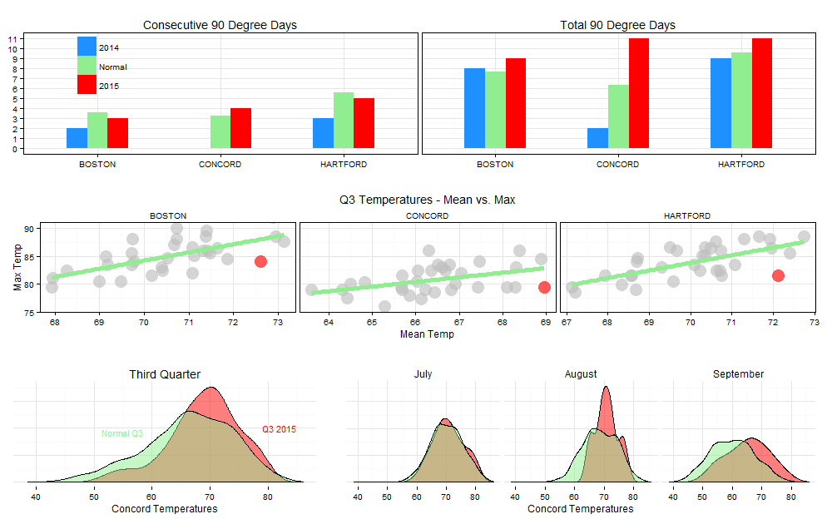
Weather Graphs
Third Quarter
2015

